Slide 1
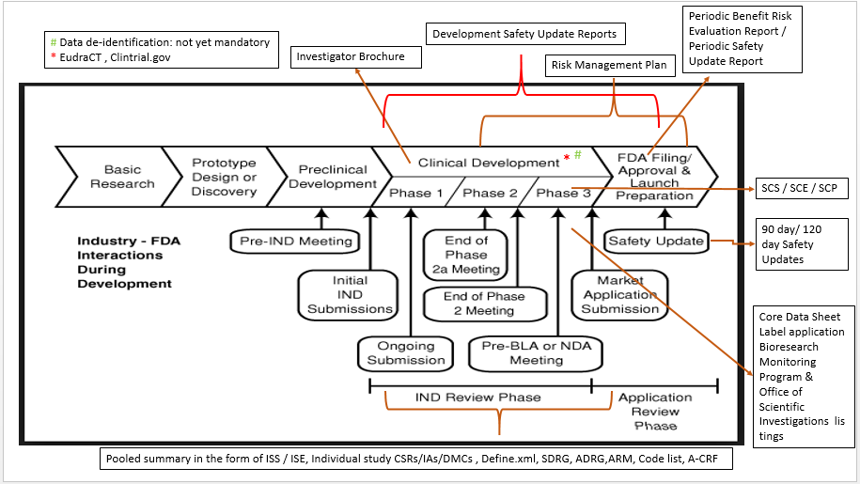
Drug Development and Submission process flow

